Slide 1
How the Computer Works
Notes:
2

Slide 2
Lecture Topics
Functions of a computer
Data versus information
Bits and bytes
Storage
Processing
How computers evolved
Notes:
3
topics include:
Functions of a computer
The difference between data and information
The definition of bits and bytes
Input devices
Output devices
Processing
Storage
Ergonomics

Slide 3
Hardware and Software
Hardware: The physical devices that make up a computer
  Computer is a system composed of several components that all work together
Typical major components:
  Central processing unit
  Main memory
  Secondary storage devices
  Input and output devices

Slide 4
Secondary Storage Devices
Secondary storage: can hold data for long periods of time
  Programs normally stored here and loaded to main memory when needed
Types of secondary memory
  Disk drive: magnetically encodes data onto a spinning circular disk
  Solid state drive: faster than disk drive, no moving parts, stores data in solid state memory
  Flash memory: portable, no physical disk
  Optical devices: data encoded optically

Slide 5
Input Devices
Input: data the computer collects from people and other devices
Input device: component that collects the data
  Examples: keyboard, mouse, scanner, camera
  Disk drives can be considered input devices because they load programs into the main memory

Slide 6
Output Devices
Output: data produced by the computer for other people or devices
  Can be text, image, audio, or bit stream
Output device: formats and presents output
  Examples: video display, printer
  Disk drives and CD recorders can be considered output devices because data is sent to them to be saved

Slide 7
Software
Everything the computer does is controlled by software
  General categories:
    Application software
    System software
Application software: programs that make computer useful for every day tasks
  Examples: word processing, email, games, and Web browsers

Slide 8
Software (cont’d.)
System software: programs that control and manage basic operations of a computer
  Operating system: controls operations of hardware components
  Utility Program: performs specific task to enhance computer operation or safeguard data
  Software development tools: used to create, modify, and test software programs

Slide 9
Random access memory (RAM):
Main memory: where computer stores a program while program is running, and data used by the program
Known as Random Access Memory or RAM
  CPU is able to quickly access data in RAM
  Volatile memory used for temporary storage while program is running
  Contents are erased when computer is off
Notes:
44
Random access memory (RAM) is a series of small cards or modules plugged into slots on the motherboard. The CPU can request any data in RAM. It is then located, opened, and delivered to the CPU for processing in a few billionths of a second.
Because all the contents of RAM are erased when you turn off the computer, RAM is the temporary or volatile storage location for the computer.
To save data more permanently, you need to save it to the hard drive or to another permanent storage device such as a CD or flash drive.
Read-only memory (ROM) holds all the instructions the computer needs when it is powered on. The data does not get erased when the power is turned off.

Slide 10
Main Memory Addresses
Address: A “name” that uniquely identifies one cell in the computer’s main memory
  The names are actually numbers.
  These numbers are assigned consecutively starting at zero.
  Numbering the cells in this manner associates an order with the memory cells.

Slide 11
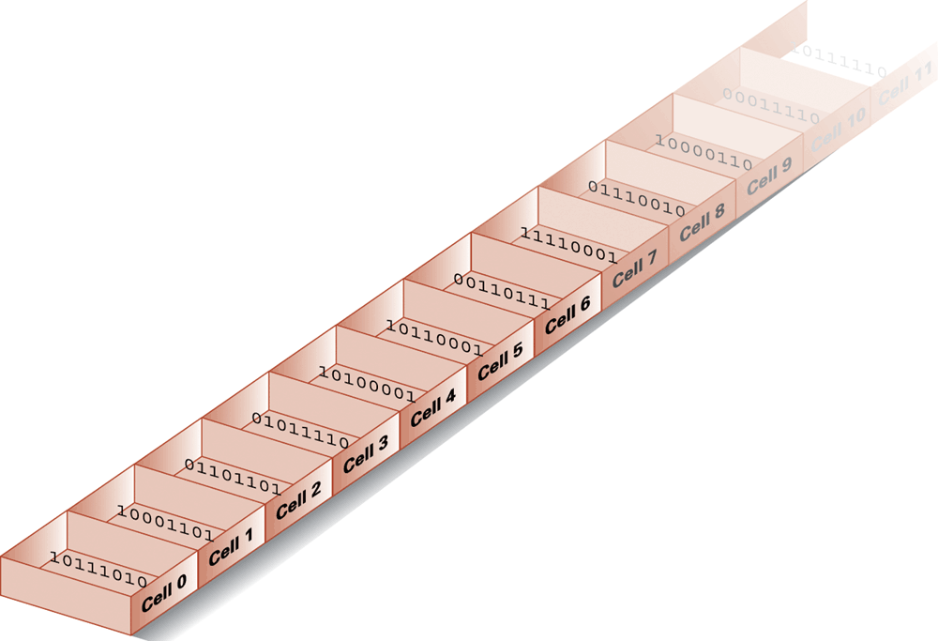
Figure 1.8 Memory cells arranged by address

Slide 12
Read-only memory (ROM):
  Stores start-up instructions
  Permanent storage
Notes:
44
Random access memory (RAM) is a series of small cards or modules plugged into slots on the motherboard. The CPU can request any data in RAM. It is then located, opened, and delivered to the CPU for processing in a few billionths of a second.
Because all the contents of RAM are erased when you turn off the computer, RAM is the temporary or volatile storage location for the computer.
To save data more permanently, you need to save it to the hard drive or to another permanent storage device such as a CD or flash drive.
Read-only memory (ROM) holds all the instructions the computer needs when it is powered on. The data does not get erased when the power is turned off.

Slide 13
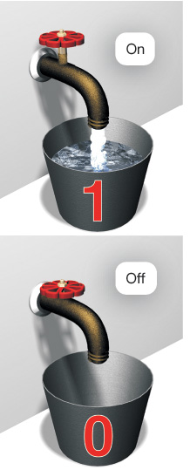
Electrical Switches
The system unit contains the CPU
The CPU uses a large number of switches
  Two states: 1 or 0 (on or off)
  Binary language consists of two numbers: 1 or 0
These switches are used to process data
Lock
Notes:
The system unit is the box that contains the central electronic components of the computer.
The central processing unit (CPU) performs functions like adding, subtracting, moving data around the system, and so on, using nothing but a large number of on/off switches.
The binary language consists of just two numbers: 0 and 1. Everything a computer does, such as process data or print a report, is broken down into a series of 0s and 1s. Electrical switches are devices inside the computer that can be flipped between these two states: 1 or 0, on or off. Computers use 0s and 1s to process data because they are electronic, digital machines.

Slide 14
The CPU
Central processing unit (CPU): the part of the computer that actually runs programs
  Most important component
  Without it, cannot run software
  Used to be a huge device
Microprocessors: CPUs located on small chips

Slide 15
Central Processing Unit (CPU)
Referred to as the “brains” of the computer
Controls all functions of the computer
Processes all commands and instructions
Can perform billions of tasks per second (over 6 billion tasks per second)
This is the part of the computer that actually runs programs
  Most important component
  Without it, cannot run software
  Used to be a huge device
Microprocessors: CPUs located on small chips
Notes:
43
The central processing unit (CPU, or processor) is the largest and most important chip in the computer.
It is sometimes referred to as the “brains” of the computer because it controls all the functions performed by the computer’s other components and processes all the commands issued to it by software instructions.
Modern CPUs can perform 6 billion tasks a second without error, making them extremely powerful components.

Slide 16
How Computers Store Data
All data in a computer is stored in sequences of 0s and 1s
Bit
  Binary digit
  0 or 1
  electrical component that can hold positive or negative charge, like on/off switch
Byte: just enough memory to store letter or small number
  Divided into eight bits
  The on/off pattern of bits in a byte represents data stored in the byte
  8 bits
Each letter, number, and character is a string of eight 0s and 1s

Slide 17
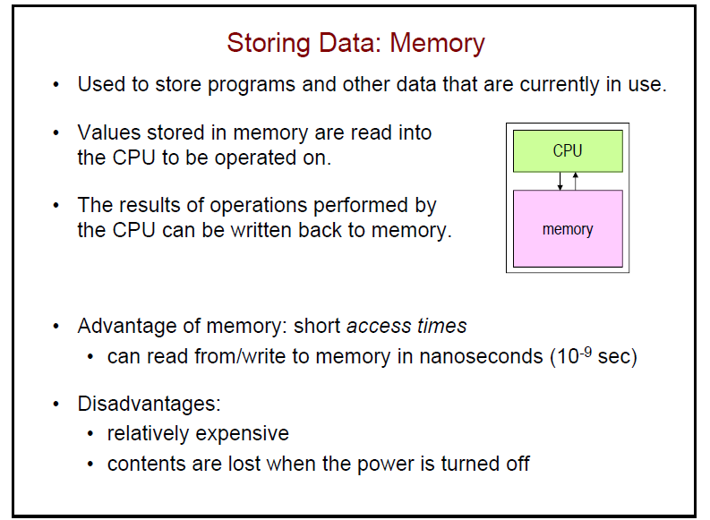

Slide 18
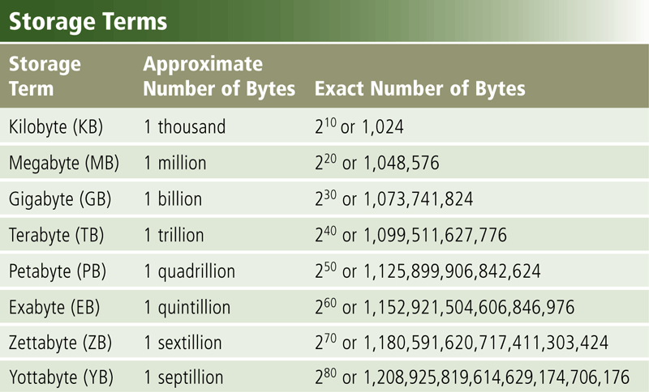
Storage
Capacity is the number of bytes a storage medium can hold
Page 354
Figure 7-2

Slide 19
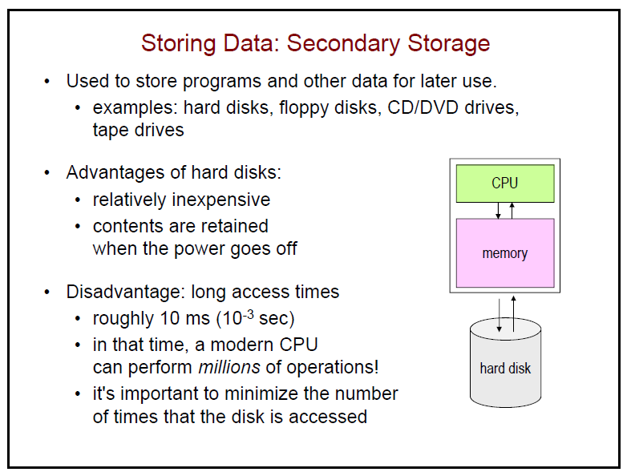
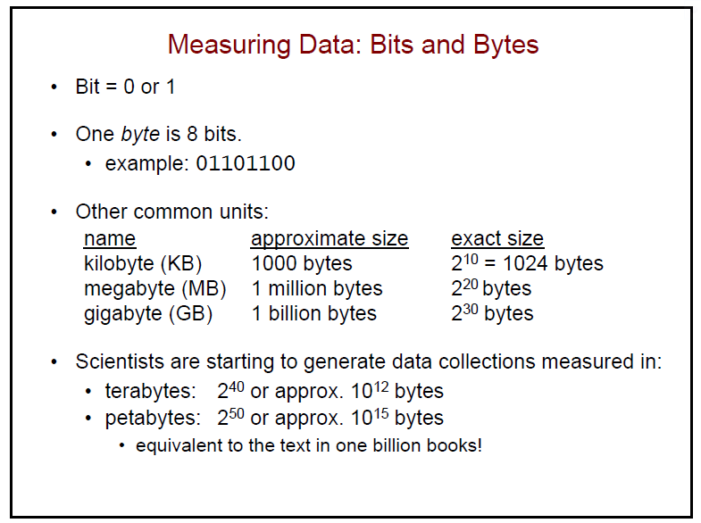

Slide 20
Storing Characters
Data stored in computer must be stored as binary number
Characters are converted to numeric code, numeric code stored in memory
  Most important coding scheme is ASCII
    There are 128 in the Standard ASCII character set, and there are 256characters in the Extended ASCII character set. Which is what most computers use
  Unicode coding scheme becoming standard
  Compatible with ASCII
  Can represent characters for other languages

Slide 21
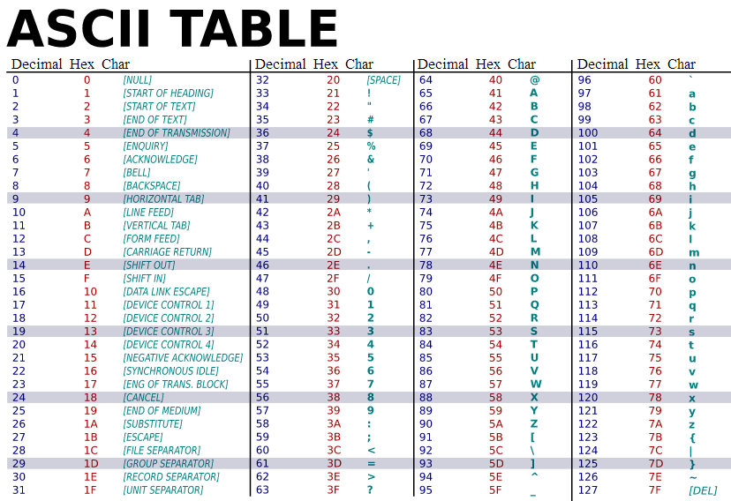

Slide 22
getty.txt
F o u r a n d s e v e n
70 111 117 114 32 97 110 100 32 115 101 118 101 110
By looking in the ASCII table, you can see a one-to-one correspondence between each character and the ASCII code used. Note the use of 32 for a space -- 32 is the ASCII code for a space.
We could expand these decimal numbers out to binary numbers (so 32 = 00100000) if we wanted to be technically correct -- that is how the computer really deals with things. (more on this later)
The first 32 values (0 through 31) are codes for things like carriage return and line feed.
The space character is the 33rd value, followed by punctuation, digits, uppercase characters and lowercase characters.

Slide 23
Storing Numbers
Bit represents two values, 0 and 1
Computers use binary numbering system
  Position of digit j is assigned the value 2^{j-1}
  To determine value of binary number sum position values of the 1s
Byte size limits are 0 and 255
  0 = all bits off; 255 = all bits on
  To store larger number, use several bytes

Slide 24
Representing Numeric Values
Binary notation: Uses bits to represent a number in base two
Limitations of computer representations of numeric values
  Overflow: occurs when a value is too big to be represented
  Truncation: occurs when a value cannot be represented accurately

Slide 25
Advanced Number Storage
To store negative numbers and real numbers, computers use binary numbering and encoding schemes
  Negative numbers encoded using two’s complement
  Real numbers encoded using floating-point notation

Slide 26
Other Types of Data
Digital: describes any device that stores data as binary numbers
Digital images are composed of pixels
  To store images, each pixel is converted to a binary number representing the pixel’s color
Digital music is composed of sections called samples
  To store music, each sample is converted to a binary number

Slide 27
Representing Images
Bit map techniques
  Pixel: short for “picture element”
  RGB
  Luminance and chrominance
Vector techniques
  Scalable
  TrueType and PostScript

Slide 28
Representing Sound
Sampling techniques
  Used for high quality recordings
  Records actual audio
MIDI
  Used in music synthesizers
  Records “musical score”

Slide 29
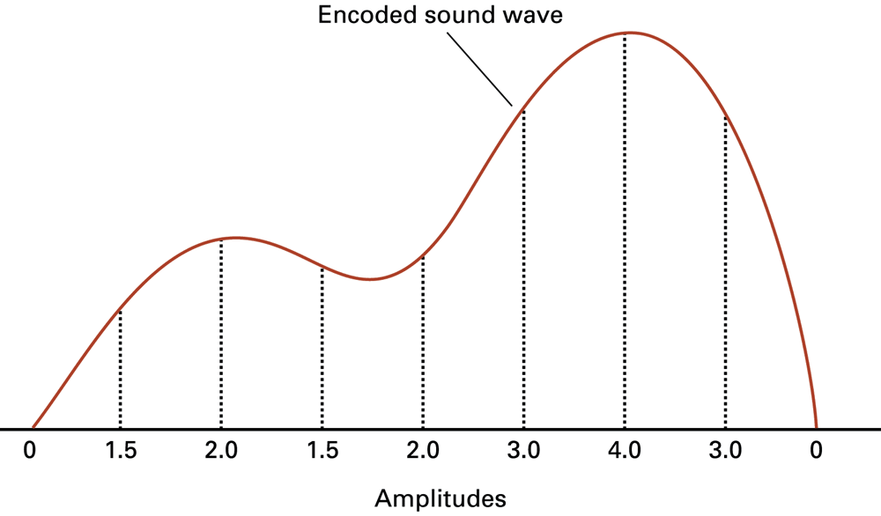
Figure 1.12 The sound wave represented by the sequence 0, 1.5, 2.0, 1.5, 2.0, 3.0, 4.0, 3.0, 0

Slide 30
Secondary Storage Devices
Secondary storage: can hold data for long periods of time
  Programs normally stored here and loaded to main memory when needed
Types of secondary memory
  Disk drive: magnetically encodes data onto a spinning circular disk
  Solid state drive: faster than disk drive, no moving parts, stores data in solid state memory
  Flash memory: portable, no physical disk
  Optical devices: data encoded optically
Reading is the process of transferring items from a storage medium into memory
Writing is the process of transferring items from memory to a storage medium

Slide 31
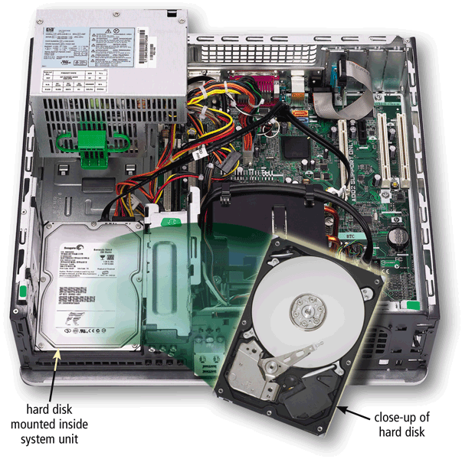
Hard Disks
A hard disk contains one or more inflexible, circular platters that use magnetic particles to store data, instructions, and information
The hard disk/drive is your computer’s primary device for permanent storage of software and documents.
The hard drive is a nonvolatile storage device, meaning that it holds the data and instructions your computer needs permanently, even after the computer is turned off
Page 355
Figure 7-5

Slide 32
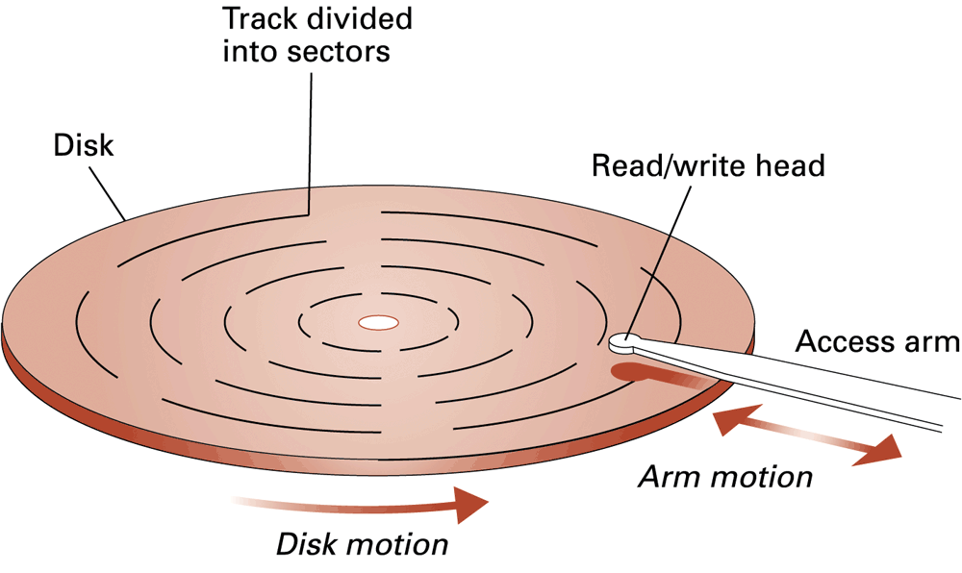
Figure 1.9 A magnetic disk storage system

Slide 33
Flash Memory Storage
Flash memory chips are a type of solid state media and contain no moving parts
Solid state drives (SSDs) have several advantages over magnetic hard disks:
Faster access time
Faster transfer rates
Generate less heat and consume less power
Last longer
Pages 362 - 363

Slide 34
Cloud Storage
Cloud storage is an Internet service that provides storage to computer users
DropBox and Box are examples
Access files from any computer
Store large files instantaneously
Allow others to access their files
View time-critical data and images immediately
Store offsite backups
Provide data center functions
Page 368
Figure 7-23

Slide 35
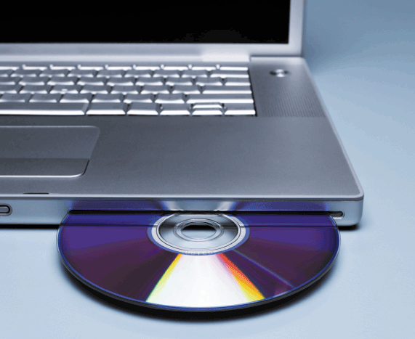
Optical Discs
An optical disc consists of a flat, round, portable disc made of metal, plastic, and lacquer that is written and read by a laser
Typically store software, data, digital photos, movies, and music
Read only vs. rewritable
DVD
DVD-RW (rewritable DVD)
Blu-Ray (5 X the storage of DVD)
Page 370
Figure 7-25

Slide 36
More About the Processing Unit

Slide 37
How a Program Works
CPU designed to perform simple operations on pieces of data
  Examples: reading data, adding, subtracting, multiplying, and dividing numbers
  Understands instructions written in machine language and included in its instruction set
    Each brand of CPU has its own instruction set
To carry out meaningful calculation, CPU must perform many operations

Slide 38
How a Program Works (cont’d.)
Program must be copied from secondary memory to RAM each time CPU executes it
CPU executes program in cycle:
  Fetch: read the next instruction from memory into CPU
  Decode: CPU decodes fetched instruction to determine which operation to perform
  Execute: perform the operation

Slide 39
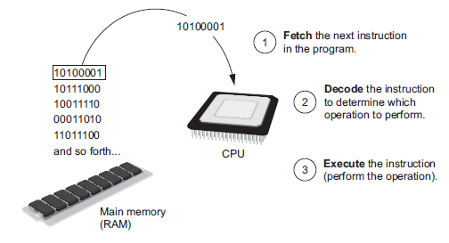
How a Program Works (cont’d.)
Figure 1-16 The fetch-decode-execute cycle

Slide 40
How a Program Works (cont’d.)
Control Unit
Manages switches inside the CPU
Remembers
  Sequence of processing stages
  How switches are set for each stage
Uses beat of system clock to move switch to correct on or off setting for each stage
Notes:
The control unit manages switches inside the CPU.
It is programmed to remember the sequence of processing stages and how switches are set for each stage.
With each beat of the system clock, the control unit moves each switch to the correct on or off setting and then performs the work of that stage.

Slide 41
How a Program Works (cont’d.)
ALU
Arithmetic Logic Unit
Arithmetic logic unit (ALU) performs
  Mathematical operations
    Addition
    Subtraction
    Multiplication
    Division
  Test comparisons (<, >, =)
  Logical OR, AND, and NOT operations

Slide 42
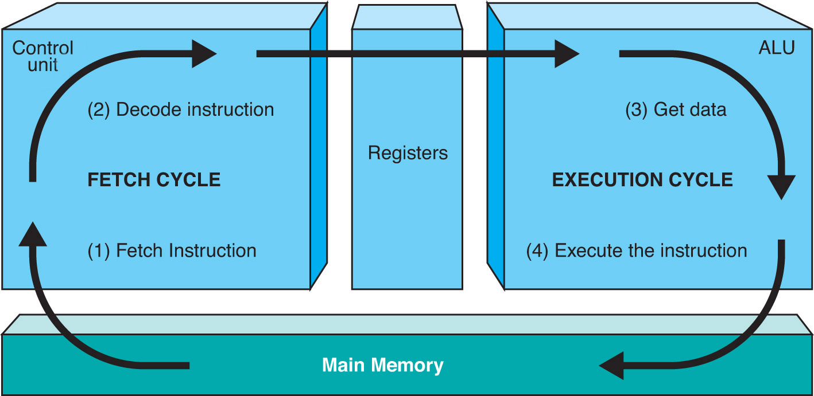
The Fetch-Execute Cycle in Detail
A register is a small storage area in the CPU.
The von Neumann architecture is characterized by the fact that instructions and data are logically the same and can both be stored in memory.
Notes:
Stage 1
Data and program instructions stored in various areas of the computer
Data moved from storage to RAM
CPU accesses RAM and moves data into registers
Cache memory
Stores recent or frequently used instructions
Faster to access than RAM
Step 2 The Decode Stage
The CPU’s control unit decodes a program’s instructions into commands
Instruction set
The collection of commands a CPU can interpret
Written in assembly language for programmers.
Assembly language is translated into machine language for the CPU
Stage 3 The Execute Cycle
Arithmetic logic unit (ALU) performs
Mathematical operations
Addition
Subtraction
Multiplication
Division
Test comparisons (<, >, =)
Logical OR, AND, and NOT operations
Stage 4 The Store Stage
Results produced by the ALU in Stage 3 are stored in the registers

Slide 43
Word Size
A computer processor handles bits in chunks called word size—
for example, a 32-bit word size transfers data within each microprocessor chip in 32-bit, or 4-byte, chunks.
A computer that uses 64-bit word size is faster than a 32-bit computer.

Slide 44
System Clock
The clock rate typically refers to the frequency at which a CPU is running. It is measured in the unit Hertz.
Moves CPU from one stage of the machine cycle to the next
Acts as a metronome, keeping a steady beat or tick
  Ticks, known as the clock cycle, set the pace
  Pace, known as clock speed, is measured in hertz (Hz)
  Today’s system clocks are measured in gigahertz (GHz) or one billion clock ticks per second.
What does it mean to say that the speed of a processor is 866 MHz?
  Ans: The processor cycles 866,000,000 times per second, which is related to the number of instructions it can process per unit time.
Notes:
To move from one stage of the machine cycle to the next, the motherboard contains a built-in system clock that acts like a metronome, keeping a steady beat and thereby controlling when the CPU moves to the next stage of processing.
These steady beats or “ticks” of the system clock, known as the clock cycle, set the pace by which the computer moves from process to process. The pace, known as clock speed, is measured in hertz (Hz), a unit of measure that describes how many times something happens per second. Today’s system clocks are measured in gigahertz (GHz) or one billion clock ticks per second.

Slide 45
How Computers Evolved

Slide 46
Moore’s Law
Gordon Moore, the cofounder of processor manufacturer Intel, predicted more than 40 years ago that the number of transistors on a processor would double every 18 months.
Known as Moore’s Law, this prediction has been remarkably accurate—but only with tremendous engineering ingenuity.
The first 8086 chip had only 29,000 transistors and ran at 5 MHz.
Notebook computers today have 820 million transistors and run at 2.6 GHz—more than 200 times faster than its original counterpart.
GlobalFoundries plans to accelerate the introduction of 14 nm (nanometer) chips in 2014,
Notes:
Gordon Moore, the cofounder of processor manufacturer Intel, predicted more than 40 years ago that the number of transistors on a processor would double every 18 months. Known as Moore’s Law, this prediction has been remarkably accurate—but only with tremendous engineering ingenuity.
The first 8086 chip had only 29,000 transistors and ran at 5 MHz.
Today’s Penryn chip (for notebook computers) has 820 million transistors and runs at 2.6 GHz—more than 200 times faster than its original counterpart.

Slide 47
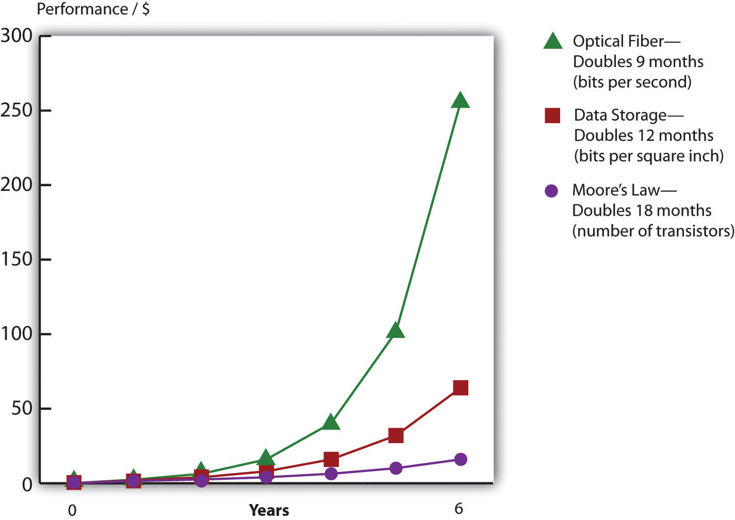
Advancing Rates of Technology (Moore’s Law)

Slide 48
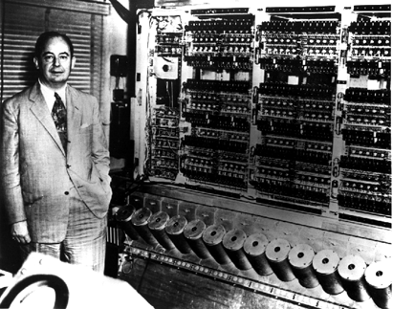
Von Neumann Architecture
“stored program”
serial uniprocessor
design
binary internal
encoding
CPU–Memory–I/O orgranization
“fetch-decode-
execute” instruction cycle

Slide 49
Electrical Switches
The system unit contains the CPU
The CPU uses a large number of switches
  Two states: 1 or 0 (on or off)
  Binary language consists of two numbers: 1 or 0
These switches are used to process data
Lock
Notes:
The system unit is the box that contains the central electronic components of the computer.
The central processing unit (CPU) performs functions like adding, subtracting, moving data around the system, and so on, using nothing but a large number of on/off switches.
The binary language consists of just two numbers: 0 and 1. Everything a computer does, such as process data or print a report, is broken down into a series of 0s and 1s. Electrical switches are devices inside the computer that can be flipped between these two states: 1 or 0, on or off. Computers use 0s and 1s to process data because they are electronic, digital machines.

Slide 50
Early Computer Switches
Vacuum tubes as switches
  Allow or block the flow of electrical current
  Take up a large amount of space
  Generate heat and burn out frequently
  Impractical due to size and reliability issues
Notes:
The earliest generation of electronic computers used vacuum tubes as switches.
Vacuum tubes act as computer switches by allowing or blocking the flow of electrical current.
The problem with vacuum tubes is that they take up a lot of space, generate a lot of heat, and must be replaced frequently.

Slide 51
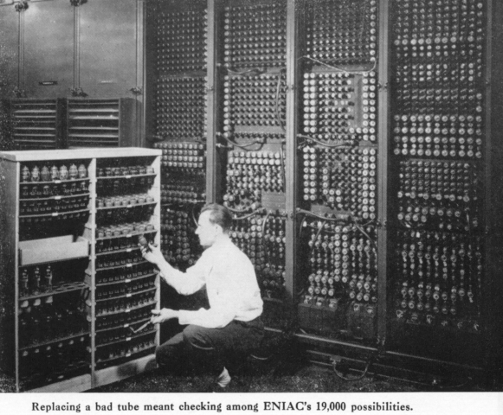
ENIAC
noted for massive scale and redundant design
decimal internal coding
operational in 1946

Slide 52
Transistors
Transistors
  Electrical switches built of layers of silicon
  Early transistors were built in separate units as small metal rods
    Each rod was a small on/off switch
  Smaller and faster than vacuum tubes
  Produced less heat
Notes:
Transistors are electrical switches that are built out of layers of the semiconductor material silicon. The silicon allows electrical current to flow easily when a certain voltage is applied, and it prevents electrical current from flowing otherwise, thus behaving as an on/off switch.
Early transistors were built in separate units as small metal rods, with each rod acting as a single on/off switch.
These first transistors were much smaller than vacuum tubes, produced little heat, and could be switched from on to off (allowing or blocking electrical current) quickly.

Slide 53
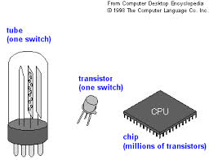
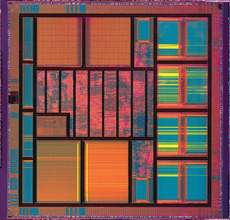
Integrated Circuits
 | Integrated circuits use solid-state technology, whereby electrons travel through solid material called silicon
Made of semiconductor material, silicon
Contain huge number of transistors, resistors, capacitors, and diodes
Small size, only ¼ inch
in diameter
Notes:
Integrated circuits use advanced fabrication techniques to fit millions of transistors into a quarter inch of silicon. Along with all the many transistors, other components critical to a circuit board (such as resistors, capacitors, and diodes) are also located on the integrated circuit.

Slide 54
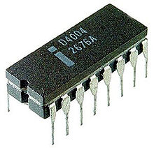
Microprocessors
Chip that contains CPU
Intel 4004
  First complete microprocessor on a single integrated circuit
  Built in 1971
  Contained 2,300 transistors
Current CPUs contain more than 500 million transistors
Notes:
Integrated circuits have enabled computer designers to create small yet powerful microprocessors, which are the chips that contain a CPU.
In 1971, the Intel 4004 was the first complete microprocessor to be located on a single integrated circuit.
Today, more than 500 million transistors can be manufactured in a space as tiny as the nail of your smallest finger.

Slide 55
The Death of Moore’s Law?
Moore’s Law is possible because the distance between the pathways inside silicon chips gets smaller with each successive generation
  Since the pathways are closer together, electrons travel shorter distances
  If electrons travel half the distance to make a calculation, that means the chip is twice as fast
This shrinking can’t go on forever
  Three interrelated forces—size, heat, and power—threaten to slow down Moore’s Law’s advance
  As chips get smaller and more powerful, they get hotter and present power-management challenges
  At some point Moore’s Law will stop because we will no longer be able to shrink the spaces between components on a chip.
5-55

Slide 56
The Death of Moore’s Law?
Microsoft, Yahoo!, and Google have all built massive data centers in the Pacific Northwest in order to benefit from cheap hydroelectric power
  The chief eco officer at Sun Microsystems has claimed that computers draw four to five percent of the world’s power
  Google’s chief technology officer has said that the firm spends more to power its servers than the cost of the servers themselves
Chips can’t get smaller forever because chip pathways can’t be shorter than a single molecule and actual physical limit may be higher
5-56

Slide 57
Buying Time
Multicore microprocessors: Microprocessors with two or more (typically lower power) calculating processor cores on the same piece of silicon
  For many applications, the multicore chips will outperform a single speedy chip, while running cooler and drawing less power
Multicore processors are now mainstream
  Today, most PCs and laptops sold have at least a two-core (dual-core) processor
  Intel has demonstrated chips with upwards of fifty cores
5-57

Slide 58
Buying Time
Another approach moves chips from being paper-flat devices to built-up 3-D affairs
By building up as well as out, firms are radically boosting speed and efficiency of chips
5-58

Slide 59
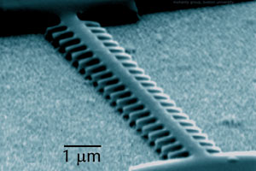
Nanotechnology
The prefix “nano” stands for one-billionth
Ability to manufacture extremely small devices
“Smart” nanodust may be combined with wireless technologies to provide new environmental monitoring systems
Current approach – start big and squeeze, press, slice, and dice to make things small
Nanotechnology approach – start with the smallest element possible (i.e., atom) and build up
This nanomechanical structure fabricated by a team of physicists at Boston University consists of a central silicon beam, 10.7 microns long and 400 nm wide, that bears a paddle-array 500 nm long and 200 nm wide along each side. This antenna-like structure oscillated at 1.49 gigahertz or 1.49 billion times per second, making it the fastest moving nanostructure yet created.

Slide 60
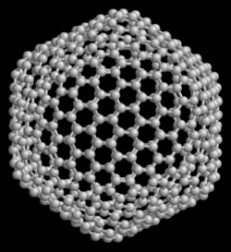
Nanotechnology Impact
Pharmaceuticals
  Drug delivery encapsulated in “nano-spheres”
Electronics
  Faster, smaller processors
  Immense storage capacities
Material Science
  Stronger materials
  Super conductivity
Buckyball from Wikipedia

Slide 61
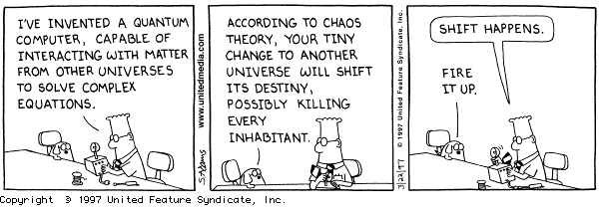
Quantum Computing
Many believe that quantum computing systems represent the next major revolution in computing
Quantum computers will be exponentially faster than today’s fastest supercomputers

Slide 62
Quantum Computing
Video - CNN
Video
Quantum computing uses qubits instead of transistors (bits)
A single qubit (utilizing particle spin) stores and processes twice as much information as a regular bit.
Combining qubits delivers exponential improvement
  Two qubits are four times more powerful than two bits
  A 64-qubit computer would theoretically be 2⁶⁴ (=18 billion trillion) times more powerful than the latest 64-bit computers!
The first prototype quantum computer (with two qubits) was created in 1998
In 2001, Almaden Research Center demonstrated a 7-qubit machine (using 10 billion billion atoms) that could factor the number 15
In early February 2007, D-Wave Systems, Inc., a privately-held Canadian firm headquartered near Vancouver, announced: “the world’s first commercially viable quantum computer”

Slide 63
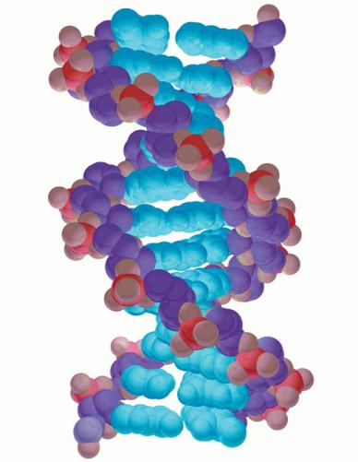
DNA Computers
Use DNA molecules and special enzymes instead of silicon chips
Because it involves the four nucleic acids represented by A, T, C, and G, it is NOT a system of binary computing.
330 trillion operations per second
100,000 times faster than current
silicon-based computers
No practical applications
yet
Notes:
Israeli scientists have devised a computer that runs on DNA molecules and enzymes instead of silicon chips. Although it has no practical applications just yet, the computer is extremely fast—it can perform 330 trillion operations per second, approximately 100,000 times as fast as any personal computer on the market today.

